Slide 1
AMPLIFIERS WITH FEEDBACK

Slide 2
OUTLINE OF PRESENTATION
4.
Gain of Negative Voltage Feedback Amplifier
1. INTRODUCTION
2.
TYPES FEEDBACK
3.
Principles of Negative Voltage Feedback In Amplifiers
5.
EXAMPLE MATH

Slide 3
INTRODUCTION
1

Slide 4
AMPLIFIER AND FEEDBACK.
AMPLIFIER:
an electronic device for increasing the amplitude of electrical signals, used chiefly in sound reproduction.
FEEDBACK:
process of injecting a fraction of output energy of some device back to the input is known as feedback.

Slide 5
TYPES OF FEEDBACK
2

Slide 6
TYPES OF FEEDBACK:
1. POSITIVE FEEDBACK: When the feedback energy is in phase with the input
signal and thus aids it, it is called positive feedback.
2. NEGATIVE FEEDBACK: When the feedback energy is out of phase with the input signal and thus opposes it, it is called negative feedback.

Slide 7
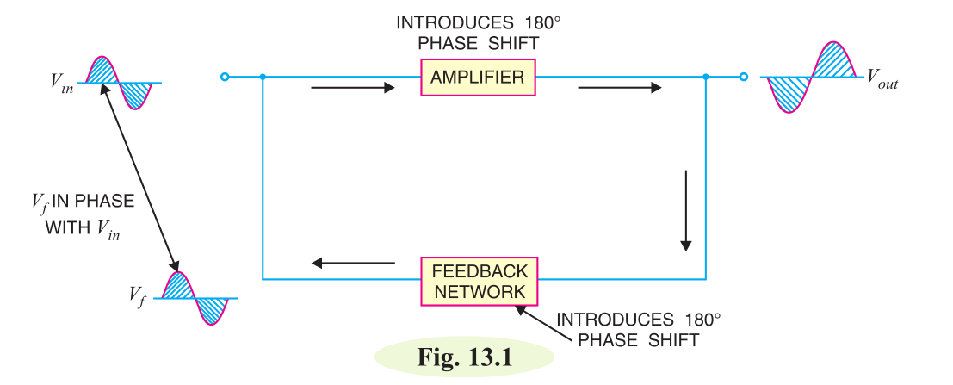
POSITIVE FEEDBACK
Both amplifier and feedback network introduce a phase shift of 180°. The result is a 360° phase shift around the loop, causing the feedback voltage Vf to be in phase with the input signal Vin.
The positive feedback increases the gain of the amplifier. However, it has the disadvantages of increased distortion and instability. Therefore, positive feedback is seldom employed in amplifiers. One important use of positive feedback is in oscillators.

Slide 8
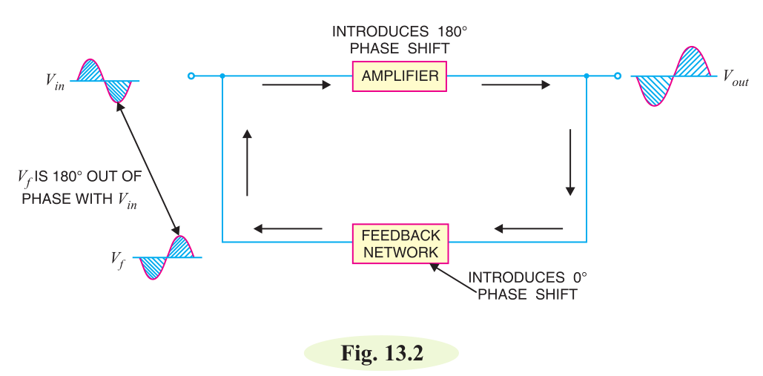
NEGITIVE FEEDBACK
As you can see, the amplifier introduces a phase shift of 180° into the circuit while the feedback network is so designed that it introduces no phase shift (0° phase shift). The result is that the feedback voltage Vf is 180° out of phase with the input signal Vin. Negative feedback reduces the gain of the amplifier. However, the advantages of negative feed-back are: reduction in distortion, stability in gain, increased bandwidth and improved input and output impedances. It is due to these advantages that negative feedback is frequently employed in amplifiers.

Slide 9
Principles of Negative Voltage Feedback In Amplifiers
3

Slide 10
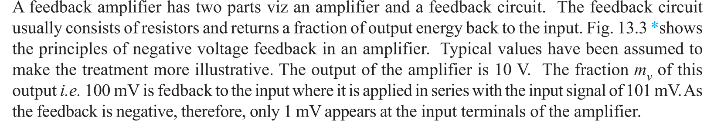
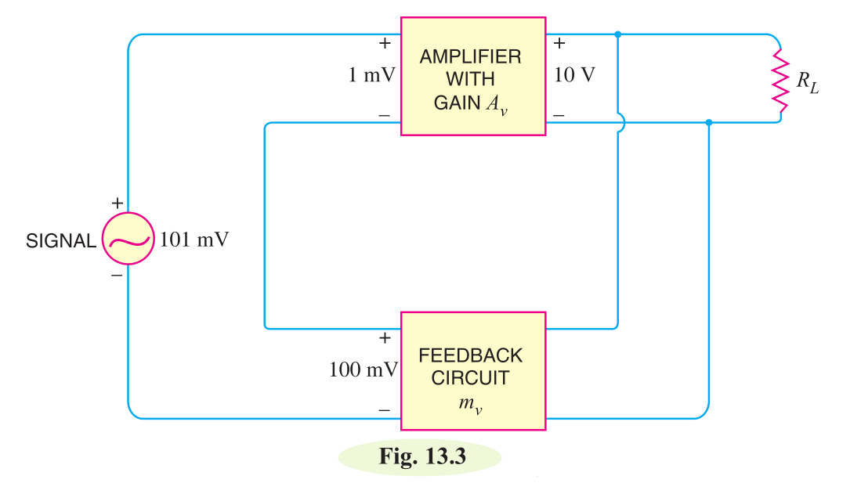

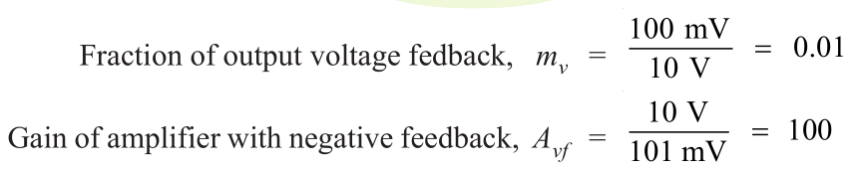
Principles of Negative Voltage Feedback In Amplifiers

Slide 11
Gain of Negative Voltage Feedback Amplifier
4

Slide 12
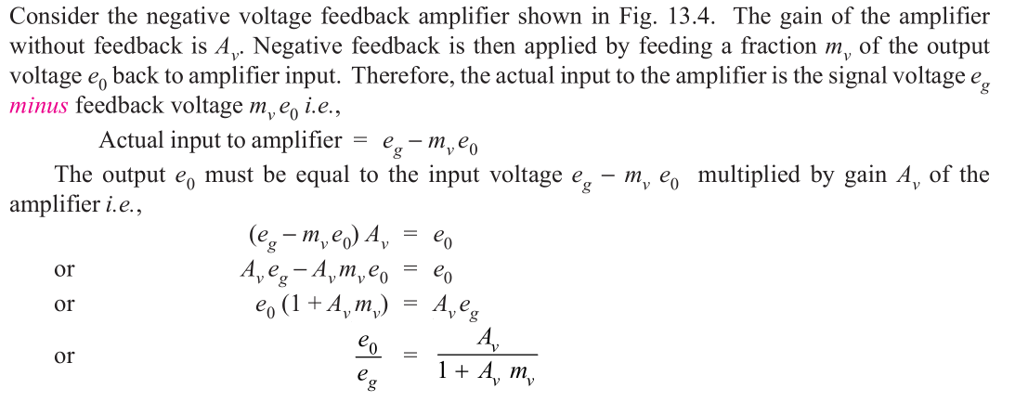
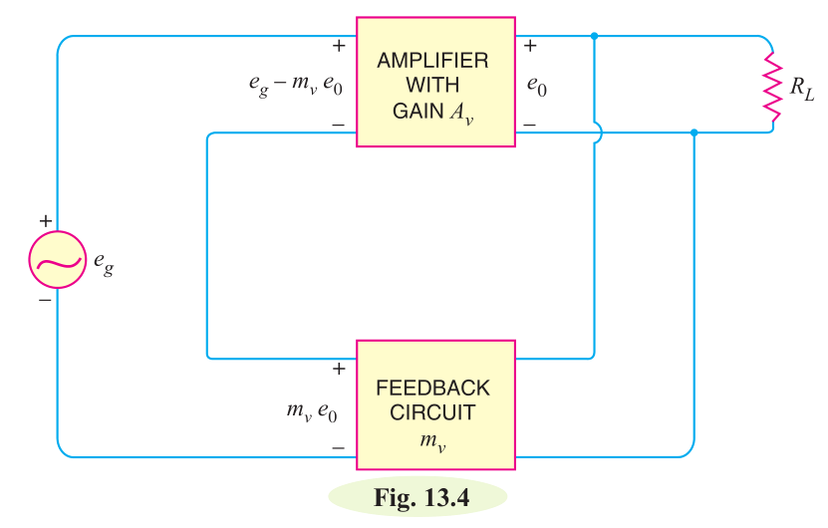
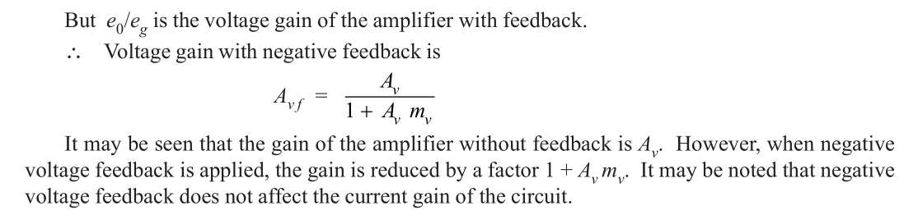
Gain of Negative Voltage Feedback Amplifier

Slide 13
EXAMPLE MATH
5

Slide 14
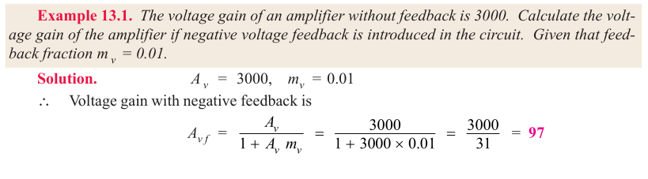
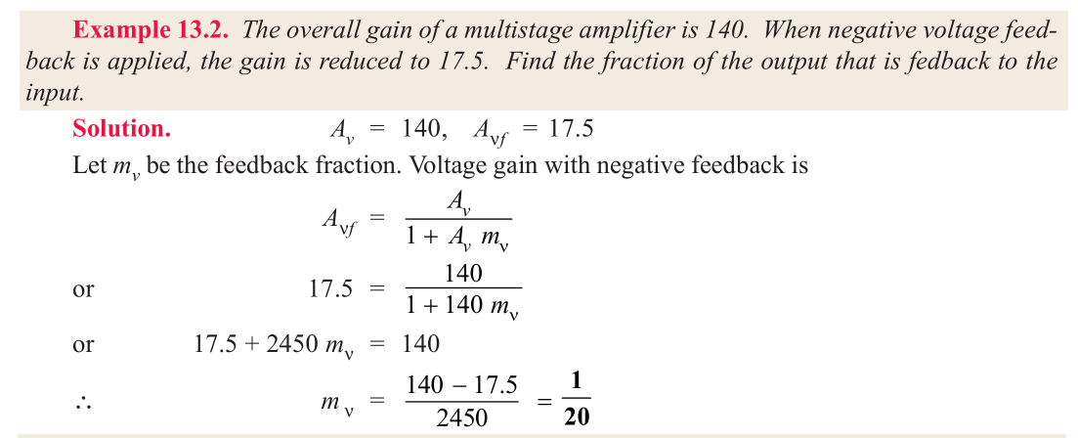
EXAMPLES

Slide 15
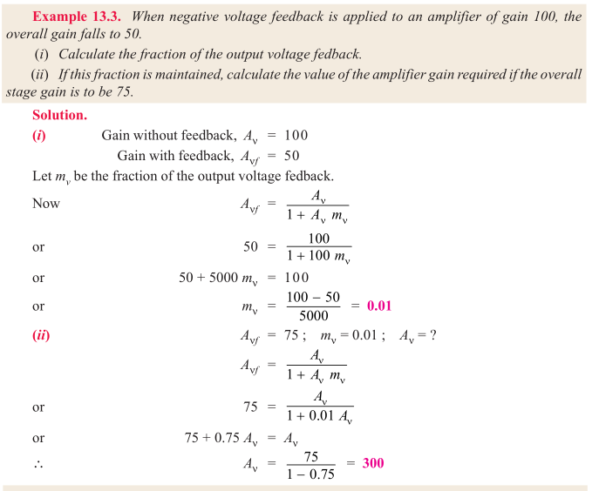
EXAMPLES

Slide 16
Thanks!
Any questions?
You can find me at @username & user@mail.me

